Slide 1
Uber Supply Demand Gap Assignment
-Submitted by Akhil Verma

Slide 2
Data Exploration
Data Set Include 6 Variables as :-
Request.id
Pickup.point
Driver.id
Status
Request.timestamp
Drop.timestamp
Aim – To Find out the supply demand gap and suggest ways to improve the situation.
Based on the “AIM” statement , we will focus on status of request , pickup points and the Number of request made in each time slots i.e. Pre Morning , Morning , Day , Afternoon , Evening , Late Night.

Slide 3
Data Cleaning and Manipulation using various analysis i.e. Data&Time extraction.
Data Inconsistencies and error spotted/checked
Duplicate values of Request.id – checked
Missing values in Request.id – checked
Missing values in Pickup.point – checked
Missing values in Status – checked
Missing values in Request.timestamp – checked
Request.timestamp was in factor format , converted it in Date: Time format for further analysis – Spotted.
Dates are not in same format , hence making it consistent by converting all “/” into “-”.

Slide 4
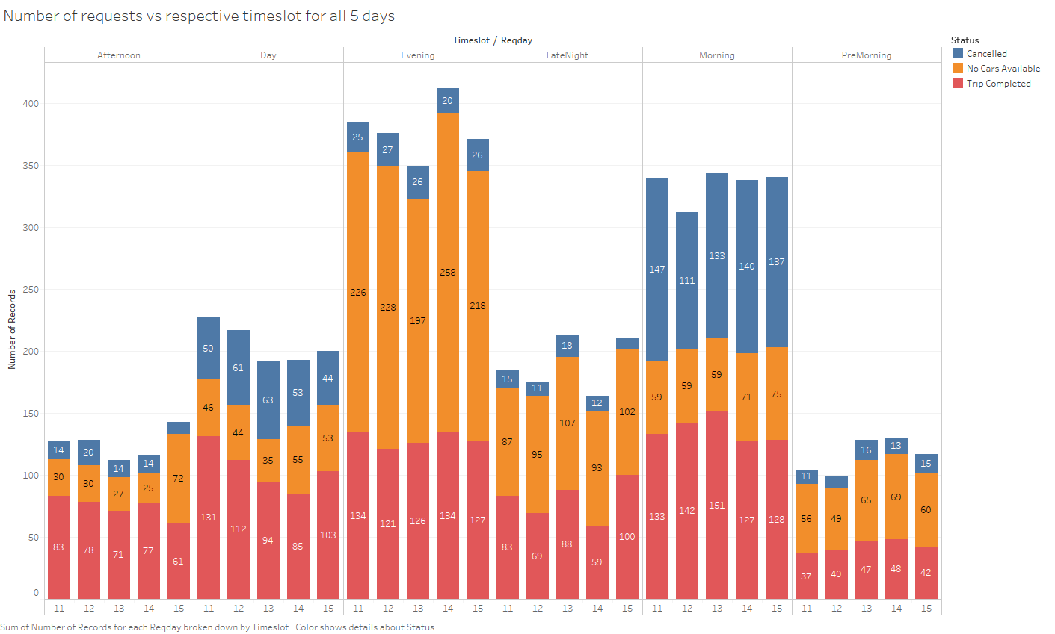
Analysis 1 – Maximum Bookings are done in Morning and Evening.
The Status of requests have a pattern throughout the data i.e. 11th July 2016 to 15th July 2016. - Maximum Bookings are in Rush hour timings , i.e. Morning and Evening.

Slide 5
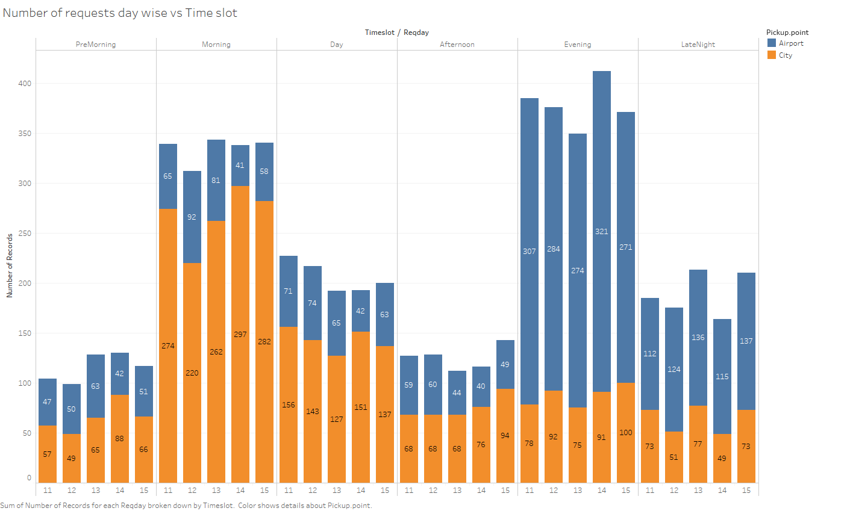
Analysis 2 – Number of requests shows a pattern with respect to Pick up points (Airport/City).
For all the days , the number of requests generated w.r.t Pickup Point shows a pattern. - Maximum requests are from City in Morning - Maximum requests are from Airport in Evening.

Slide 6
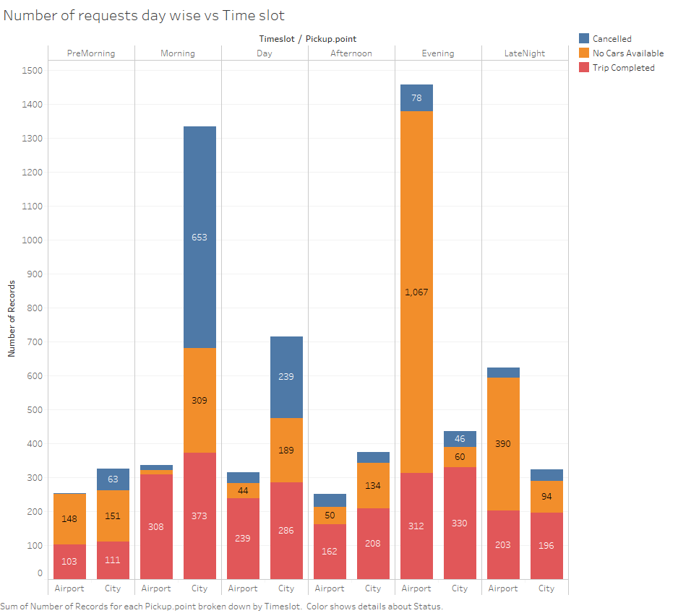
Combining Pickup Point and Status of Requests.
Since all the days are showing same pattern observations after clubbing the data w.r.t days. Conclusions after clubbing data :- -Number of Trips in morning are high from City. -Number of Trips in evening are high from Airport.

Slide 7
Time Slot Bins Created with a gap of 4 hours each.
Time | Category
12AM – 4AM | Pre Morning
4AM- 8AM | Morning
8AM-12PM | Day
12PM-4PM | Afternoon
4PM-8PM | Evening
8PM-12AM | Late Night

Slide 8
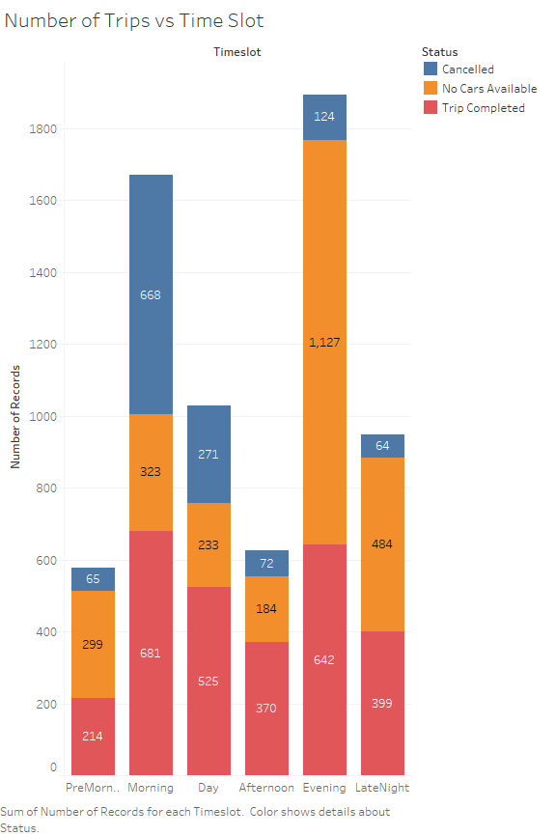
Problem Faced – Morning and Evening (Rush hour timings)
Graph Clearly states us that maximum bookings are done in morning and Evening as per our “Analysis 1 in slide 3”.
Maximum Cancellations are in the Morning Timeslot. i.e. 668.
Maximum Unavailability of drivers are in the Evening Timeslot i.e. 1,127.

Slide 9
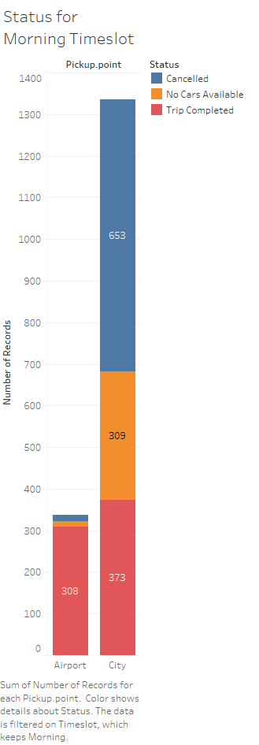
Problem(part A)-Demand and Supply in Morning From City
As we can see in plot , the supply from city is 373 While the demand is 373+309+653 =1335.
((653/1335)*100) = 48.9% of the requests get cancelled in Morning.
The Difference between Demand and Supply is 1335-373=962.

Slide 10
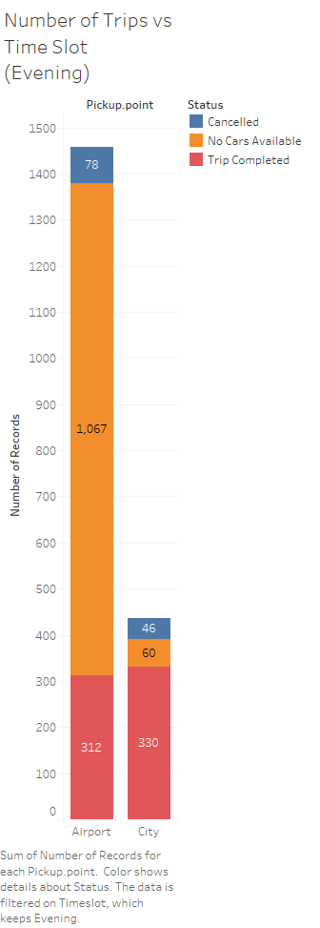
Problem(part B)-Demand and Supply in Evening From Airport
As we can see in plot , the supply from Airport is 312 While the demand is 312+1067+78 =1457.
((1067/1457)*100) = 73.23% of the Requests are not filled Because of no availability of cars/drivers.
The Difference between Demand and Supply is 1457-312=1145.

Slide 11
Resolutions of problems mentioned above.
For Morning Timeslot
For the morning trips , drivers can be given incentive to make them more active for morning trips and drivers will not decline the requests.
Uber can give a fixed amount to drivers if they complete 3 requests made to airport in morning. If more and more drivers do these 3 requests , this will ensure to bring the demand-supply gap to lowest.
Uber can give 10% of the fare to drivers as Fuel money recovery , oftentimes drivers have to return back to city without a ride. This will keep the drivers motivated and they will not decline the requests to airport in Morning. For Evening Timeslot
Uber should give the pooling option at airport , such that less cars can serve more passengers at the same point. This will ensure that more than 1 requests are fulfilled by low number of rides available.
Uber should pay for parking tickets at airport for drivers , such that drivers are available all the time in evening time slot. This will ensure that the percentage of no rides available will be lower and hence Deman-Supply gap can be taken care of.

